Slide 1




RELATIONAL DATABASE
AWS Managed: Run:AWS
Backup:AWS
Versioning:AWS
Maintenance:AWS
Manually
Mysql
Mariadb
PostgreSQL…
Mysql
Mariadb
PostgreSQL….
EC2

Slide 2




RELATIONAL DATABASE
EC2
EC2

Slide 3

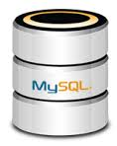
DB instance identifier =RDS-mysql
Master username=admin
Master password: Pl123456789
Initial database: clarusway

Slide 4


Remote
EC2
Remote
GUI (Graphical User Interface)

Slide 5

Messenger
Msql Client
Remote
EC2
Remote
Terminal

